Slide 1
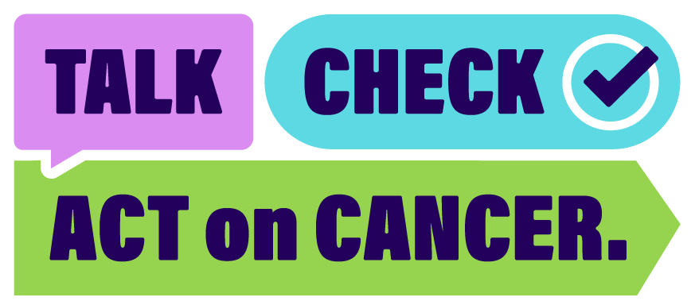
Slide title here
Slide subtitle here

Slide 2

Let’s make it normal to talk about cancer. The more we share, the less overwhelming it feels.
Early conversations can save lives.

Slide 3

Listen to your body. If something feels different or it’s been 3 weeks or more, get it checked by your doctor.
Most changes won’t be cancer, but it’s always worth checking.

Slide 4

Book your doctor’s appointment, complete your screening and follow the recommended advice given by your doctor.
If you’ve noticed something different, acting early could save your life.

